Slide 1
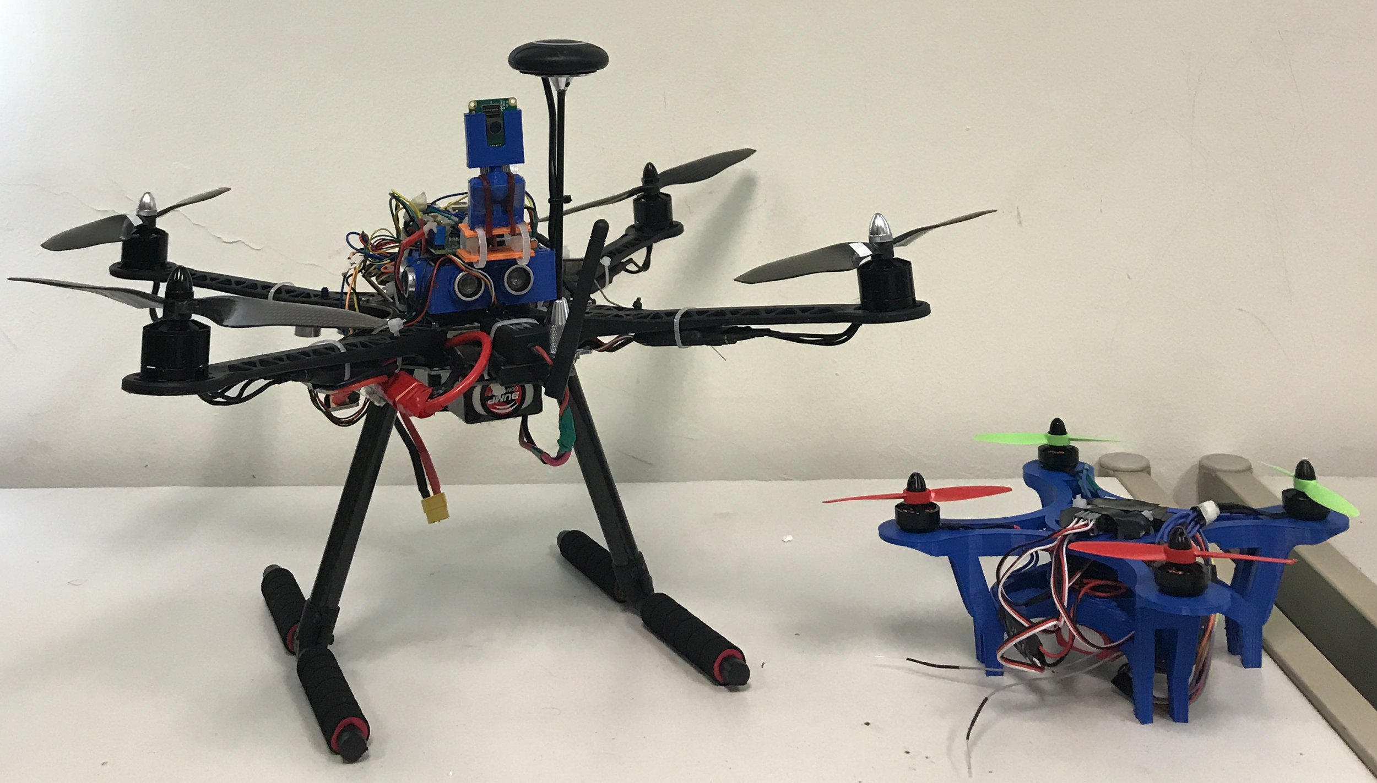

Autonomous Drone
3D scanning with smart drone

Slide 2
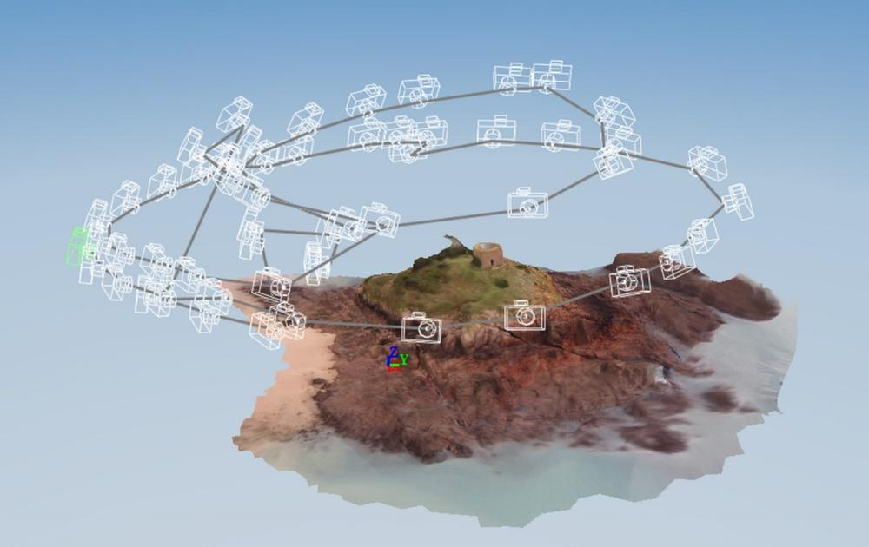
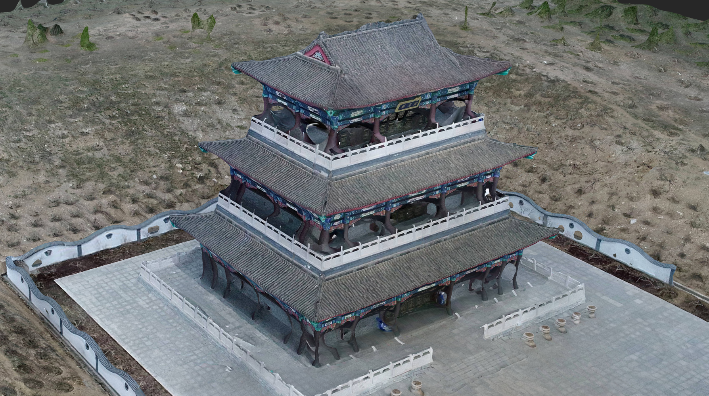
Our objective
3D scanning a large object with waypoint setting by autonomous drone at low cost

Slide 3
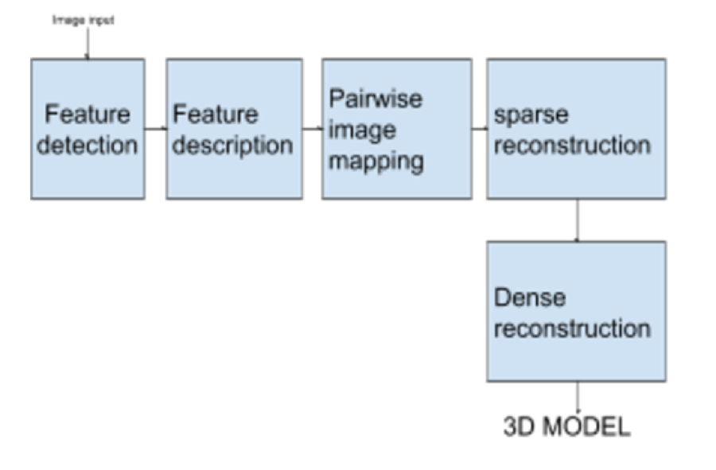
Our solution
Drone equipped with camera and sensors
Autonomous flight with waypoint setting / circle
Image acquisitions
3D processing : Image pair matching, sparse reconstruction, dense reconstruction

Slide 4
Drone equipments
Quadcopter
Raspberry PI and Camera module
Pixhawk Flight Controller with GPS
Smart-phone controller / Remote controller
Sensors integration: ultrasonic, rangefinder, temperature and humidity
Telemetry / WIFI / 4G LTE connectivity

Slide 5
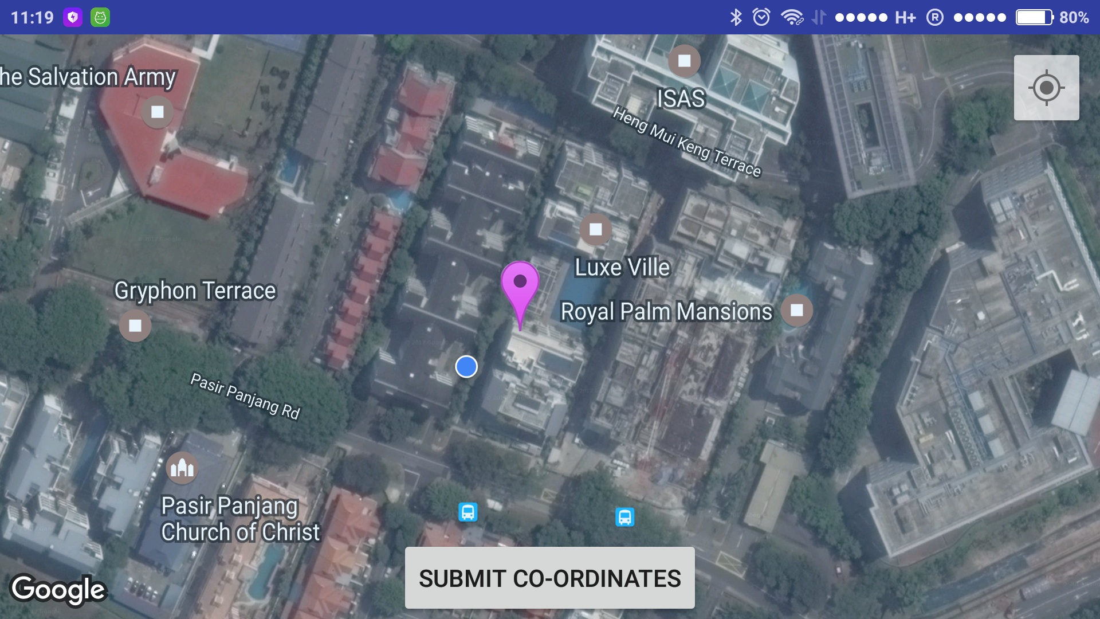
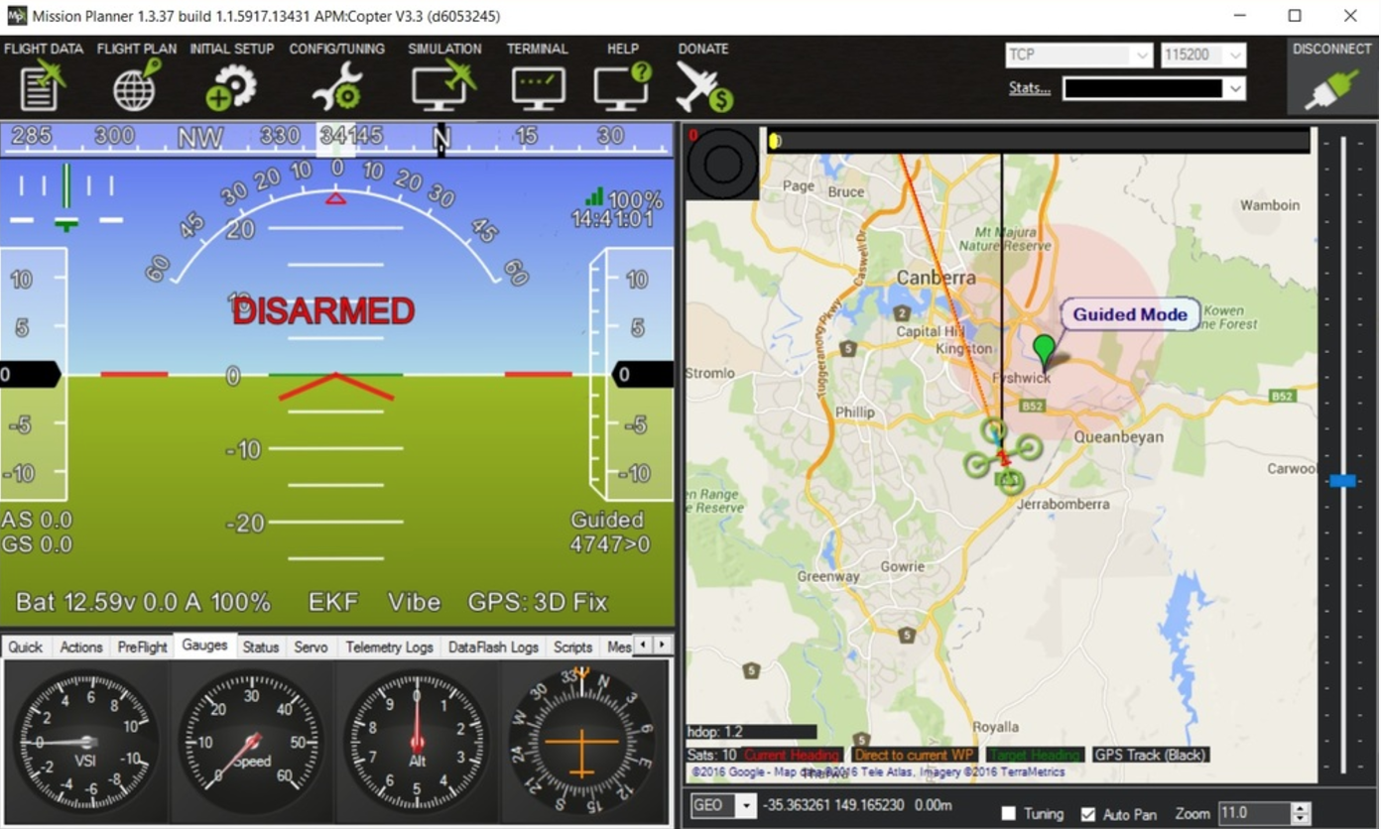
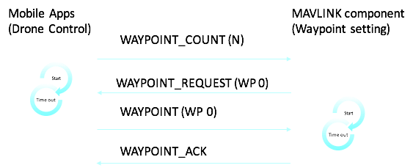
Waypoint setting
Smartphone apps
Groundstation apps
Setting flight path on maps
Upload to drone
Ready to fly

Slide 6
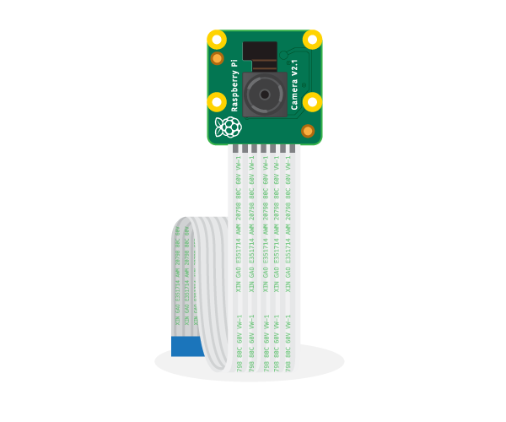
Image acquisitions
RPI Camera with 8 Mega Pixel
Image stabilisation
Image capture automation script
Image storage

Slide 7
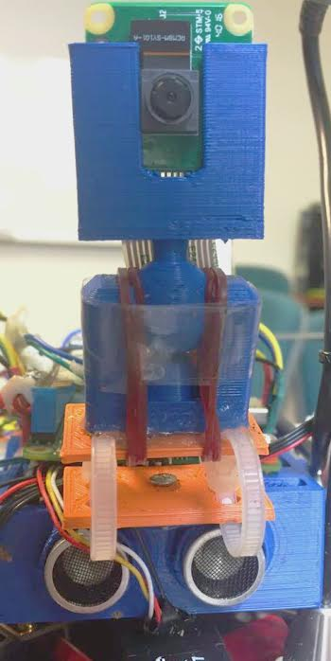
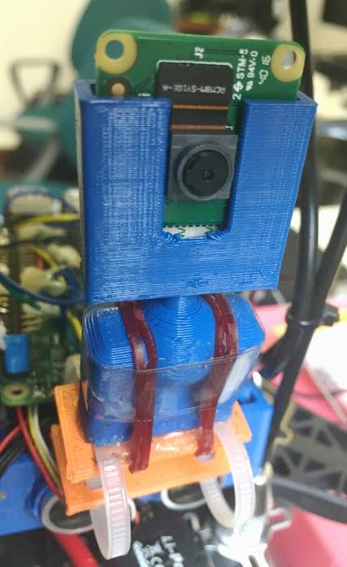
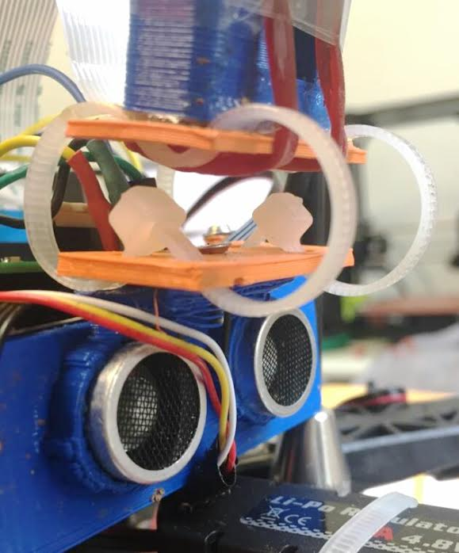
Camera Stabilization
Ultrasonic
Sensors

Slide 8

3D processing
Method : Structure-from-Motion
Workflow :
Drone -> Images -> Visual SFM -> 3D point clouds -> Mesh Lab
Notes:
Taking images with waypoint setting in different altitudes and if possible combine with some lower parts pictures or ground pictures for better details
Stitch images together using Visual SFM software. This glues images together based on the image pair matches/pixel points.
Using Visual SFM software to do sparse reconstruction, dense reconstruction, and output model as 3D object file e.g obj, this file can be opened with any 3D model editor like Meshlab

Slide 9
Structure From Motion(SFM)
Sequences of 2D images →3D model
Bag of visual words is used in image classification.Three major steps involved
Feature detection
Feature description(SIFT)
CodeBook Generation
Working of SFM
Image input->pairwise image mapping->sparse reconstruction->Dense reconstruction

Slide 10
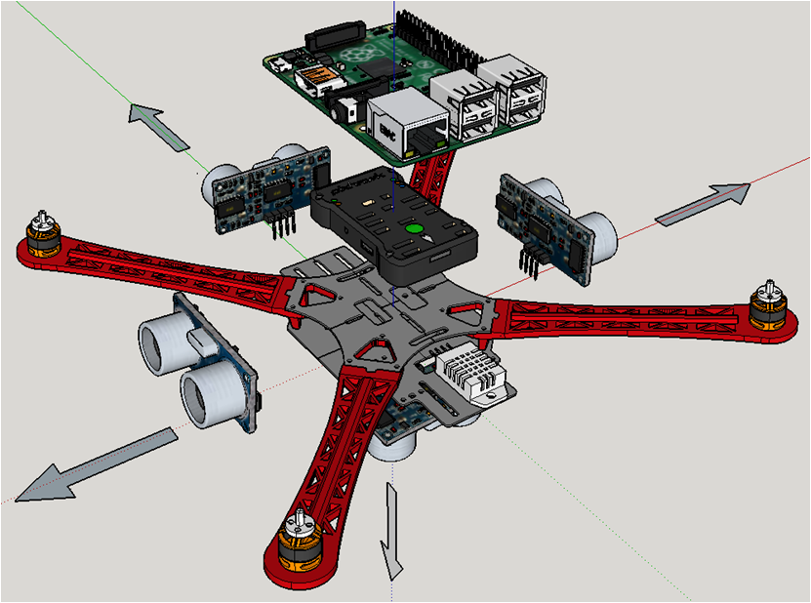
Sensor Integration with Raspberry Pi
3D view of 4 ultrasonic sensors, humidity & temperature sensor, pixhawk flight controller and Raspberry Pi assembled on Quadcopter frame

Slide 11
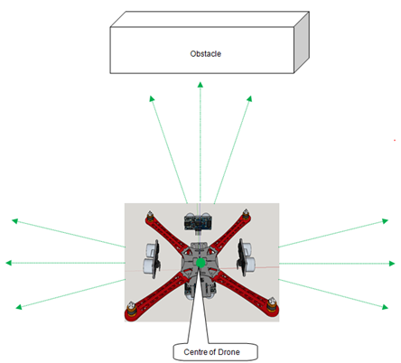
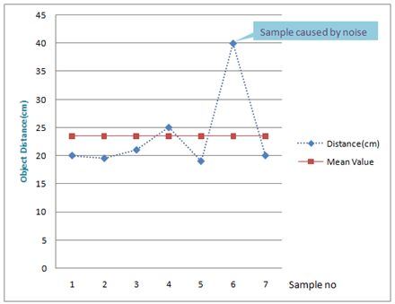
Obstacle Detection
Angle of measurement of ultrasonic sensor(30 degree)
7 Sampling points taken from each ultrasonic sensor and calculation of mean value

Slide 12
Four ultrasonic sensors installed in front, left, right and bottom are monitoring and checking whether there are any object within the range at all times during the flight.The HC-SR04 ultrasonic sensor has a measurement angle of 30 degree.
When the obstacle is within the range of predefined distance (let’s say 50 cm), the python application will receive notification and perform necessary actions based on algorithm and information provided by four ultrasonic sensors (i.e stop moving, hover and turn right if the object is in front and other obstacles in other directions).

Slide 13
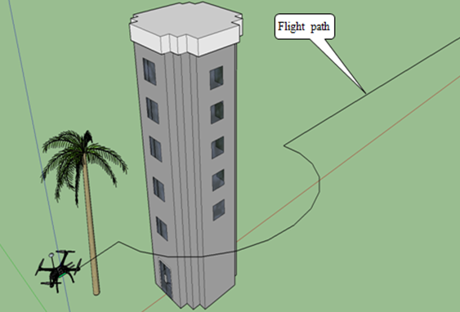
Obstacle Avoidance
Illustration of UAV’s Obstacle Avoidance

Slide 14
The below are the steps of the algorithm:
Step 1: Get all ultrasonic sensors’ readings in thread running concurrently in Python application.
Each ultrasonic sensor acquires 7 samples and calculate mean value in order to avoid inaccuracy caused by unwanted noises and electrical spike, etc.
Step 2: Check whether there is any object within the range of 50 cm.If there is an object within the specified range, it is considered that obstacle is detected and command the drone to stop moving forward , move back a little bit and hover.
Step 3: Check the direction of the obstacle with respect to the drone.
Step 4: Check whether there are other obstacles in other directions.
Step 5: Decide to avoid the direction where obstacle exists and move in the direction where there is no obstacle and proceed to the destination.

Slide 15
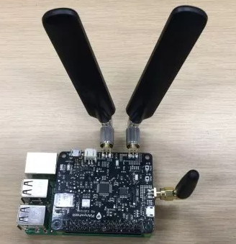
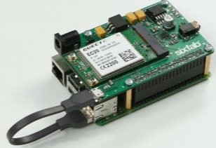
4G LTE Connectivity
Pianywhere 4G LTE board
Sixfab 4G LTE board

Slide 16
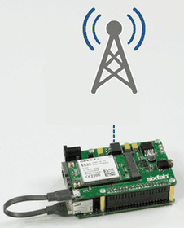
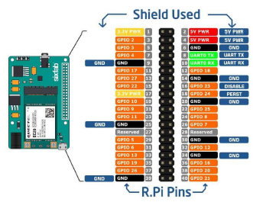
Use 4G LTE ultra fast internet connectivity
Sixfab 4G LTE shield and connection diagram with Raspberry Pi’s GPIO header

Slide 17
Smart Drone App
Establishes server-client connection
Incorporates the following features
Voice control (Google Speech API)
App screen control
Autonomous flying (Waypoint setting)
Cooperative control (Phone accelerometer and magnetometer sensors)
Location tracking (Google Maps API)
Altitude calculation (Google Elevation API)
Sensor monitoring
Text to Speech (Google TTS API)
Image capture and storage

Slide 18
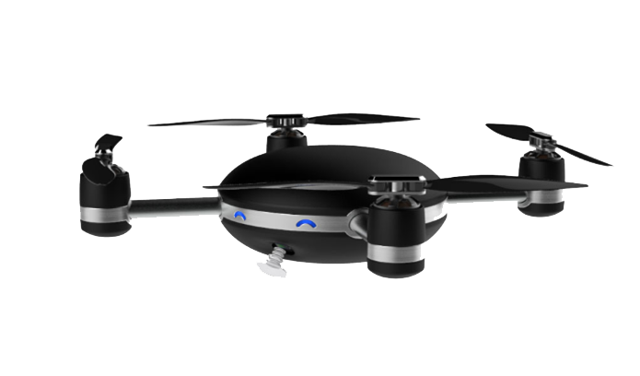
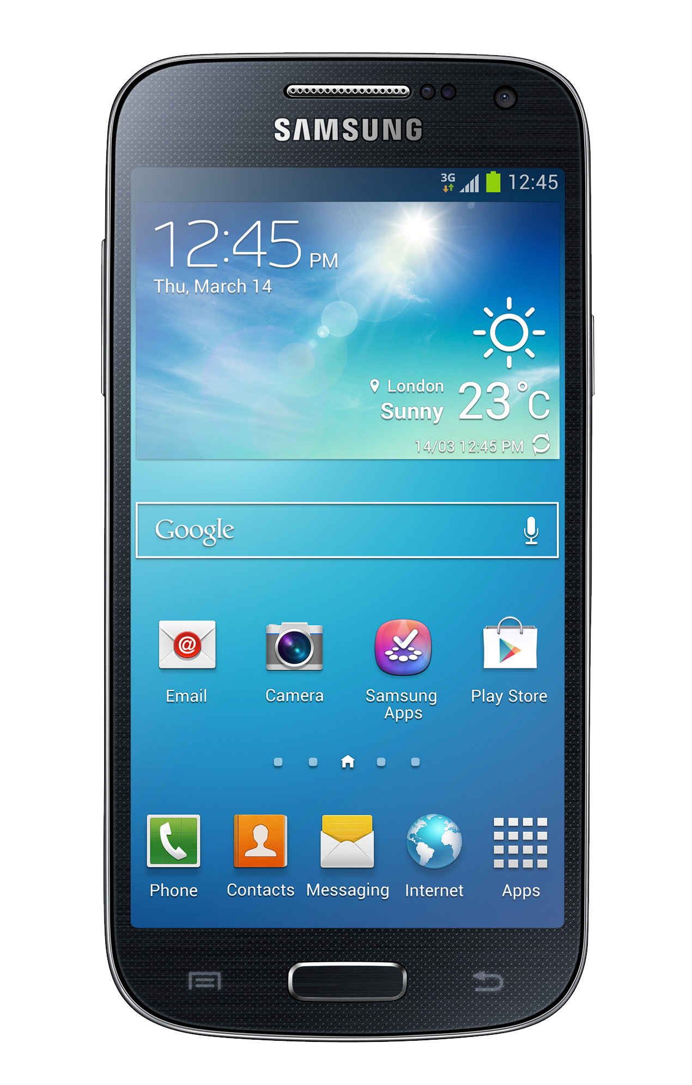

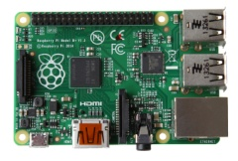
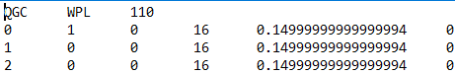
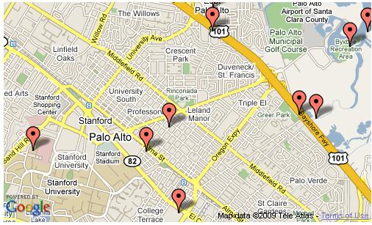
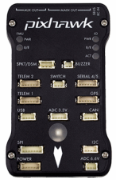
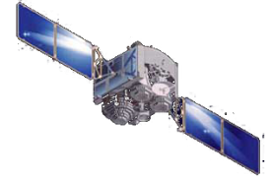
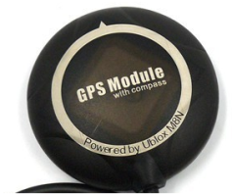
Waypoint Navigation
Wireless communication
Pi
Create Mission file following MAVLINK Protocol
Send Current Coordinate every 1 sec
Upload mission to Pixhawk for Navigation
GPS Receiver
Plot Waypoint on mobile app
using Google maps API
Ref: http://python.dronekit.io/guide/auto_mode.html

Slide 19
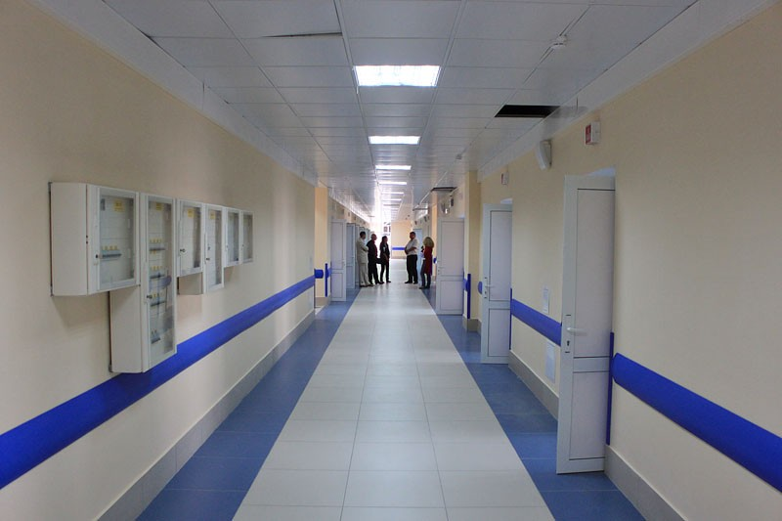
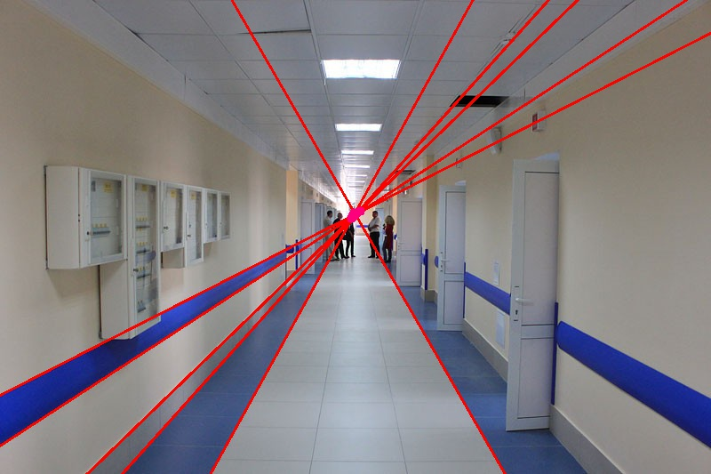
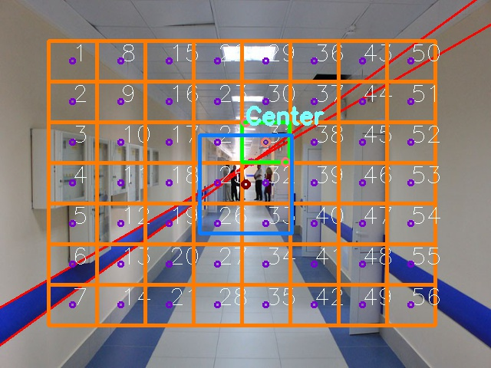
Future works
1. Internal Corridor Navigation:
Using concept of Vanishing Point and new Grid structure for navigation.
Source
Vanishing Point
GRID and navigation
Notes:
Current Limitation:
Works in well light interior.
Fault Tolerance need to be introduced.
Make it fast for real time processing.
Can be integrated with Distance sensor to make more reliable decisions.

Slide 20
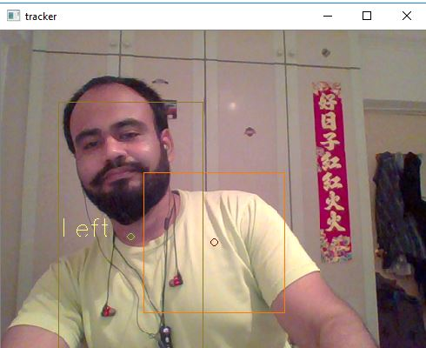
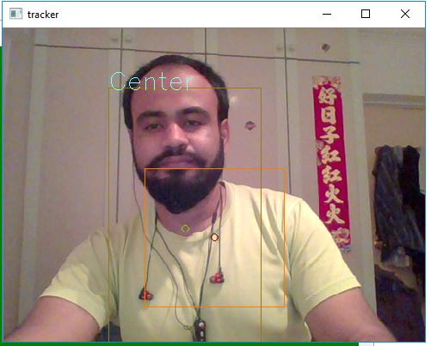
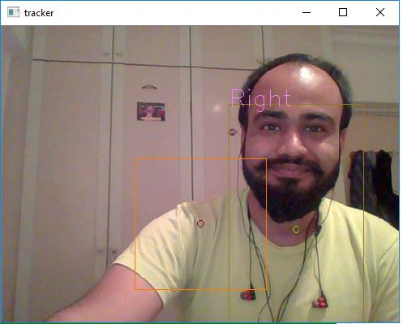
Future works
2. Human detection and Tracking:
Detect Human using HOG detectors and pre-trained SVM machine to classify and then track human using dlib Correlated tracker.
Send Navigation to drone based on tracker window using in house technique we call IN-BOX.
Notes:
Current Limitation:
Can Track only single person in a frame , Fail when multiple human detected.
Have to introduce Fault tolerance method.
Currently only left and right Yaw capable, need to input more logic for other movements.
Integration with depth sensors to have added features can be done.

